Slide 1
Predicting Fraud within the Premium Tax Credit Filing Population
Data Science Intensive
Capstone Project Presentation
Travis Williams
October 16, 2017

Slide 2
Problem
The Premium Tax Credit (PTC) is a tax credit that is associated with the Affordable Care Act legislation. Qualifying taxpayers can use this credit to help subsidize (pay for) their insurance by signing up through the Federal Insurance Marketplace and then claiming the credit when they file their tax return.
Past research has shown a number of tax returns are filed that seek to fraudulently claim the PTC credit. IRS operations do not have the resources to physically examine all tax returns.
Though filtering algorithms exist to identify fraudulent returns for certain tax credits, the PTC has not yet been added to these filters.

Slide 3
Customer and Solution
Certain IRS operations are tasked with the identification and prevention of fraudulent tax returns.
These IRS operational areas were interested in improving their filters to include metrics to flag fraudulent PTC returns for examination.
To address this need, I chose to create a set of predictive models that would identify fraudulent PTC tax returns.

Slide 4
Data Wrangling
To build my dataset, I used several IRS internal sources of data related to PTC returns:
PTC Scored Report- Business Objects report that contains a list of tax returns that claimed the PTC. This report includes demographic and other information about the tax returns.
Audit data- The IRS has audit data for tax returns contained in a giant data warehouse known as the Compliance Data Warehouse (CDW).
By combining these two data sources, I was able to create a dataset of 77 features and one target variable.

Slide 5
Dataset Important Fields
My original dataset contained 77 features that were categorized into three main areas:
Behavioral factors such as specific tax forms, calculation errors, and timeliness of return filing.
Monetary factors such as taxpayer Adjusted Gross Income (AGI), amount of PTC claimed, etc.
Demographic factors such as taxpayer age, location, etc.
The dataset contained a target variable that identified the tax return as being assessed as fraudulent or non-fraudulent.
Using my existing knowledge of IRS operations, I eliminated 20 features I felt were non-relevant to determining fraud within PTC returns.

Slide 6
Dataset Limitations
Despite the breadth of features, a number of limitations existed with the dataset:
The audit data was outdated. As the most complete audit data the IRS has is from Tax Year 2014, this potentially limits the effectiveness of the model in identifying current year fraudulent PTC returns.
Data will not uncover reasons behind fraud schemes. As the current data is quantitative, it fails to provide in-depth behavioral information regarding the fraud schemes.
Data is biased. The data comes from audit cases, which were likely referred to audit for suspicious reasons. Thus, it likely contains a higher percent of fraudulent cases than in the overall PTC return population.

Slide 7
Exploratory Analysis
Initially, I wanted to get a sense for the features that had the largest impact in whether a PTC tax return was fraudulent or not.
I chose to employ a Pearson Correlation to identify features that showed the largest correlation with filing a fraudulent PTC return.
I assessed the p value for the relationship between the features with the three strongest correlations to fraud to determine each feature was statistically significant.

Slide 8
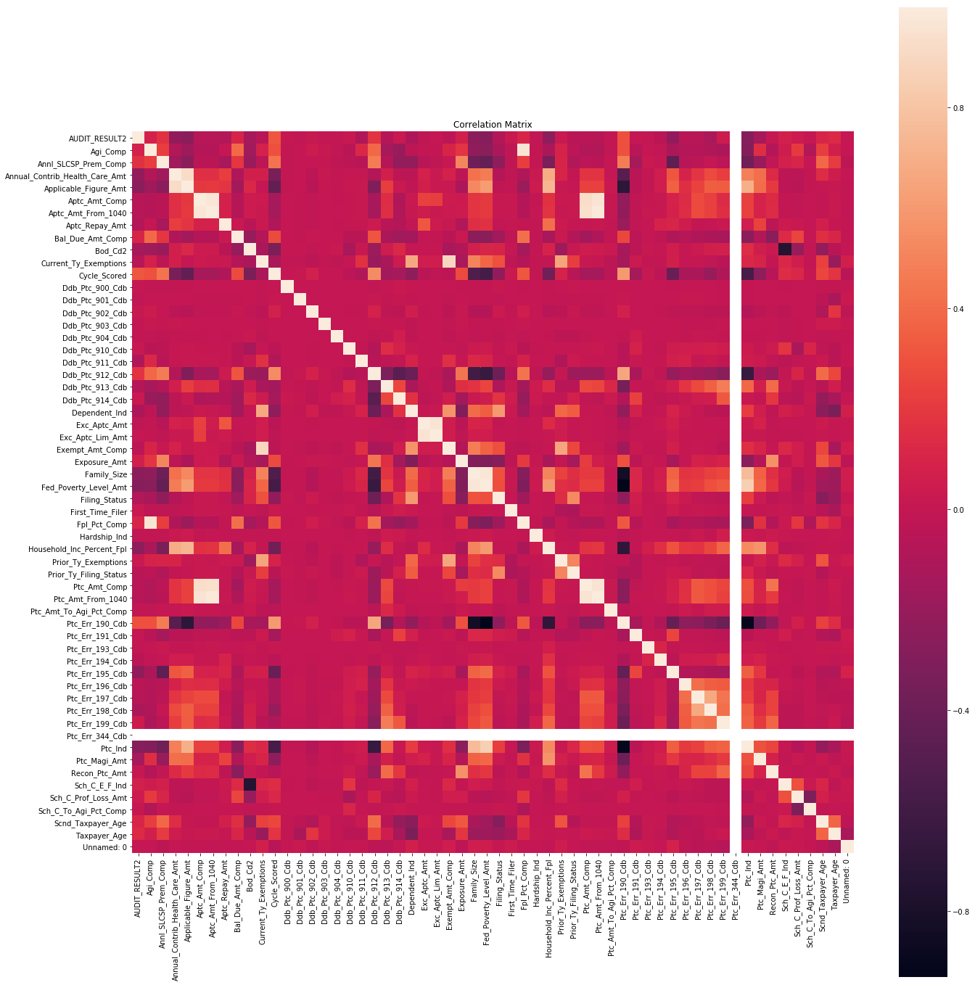
Background Findings
Results of the Pearson Correlation showed the features with the highest correlation coefficients with a fraudulent return were:
The cycle the return was processed by the IRS.
Whether or not the taxpayer attached a Form 8962 with their tax return.
The calculated amount for the taxpayer’s Federal Poverty Level, which is based on the taxpayer’s family size and influences the amount of PTC they qualify for.

Slide 9
Machine Learning Model Selection
As my dataset included a target variable that showed which cases were fraudulent, I applied supervised learning algorithms to identify fraudulent PTC tax returns.
I chose to apply two algorithms commonly used in case classification problems such as this: Logistic Regression and Random Forest. Both of these techniques work well when the dataset has a large amount of cases compared to input variables.
In this case, I had 8,438 cases and 57 input variables, so it these algorithms were an appropriate choice.

Slide 10
Method and Model Improvement Steps
I used K-Fold cross validation to more accurately assess performance of each model.
In addition, I used several techniques to improve model performance:
L1 Regularization to reduce dimensionality of my Logistic Regression model
Sci-Kit learning tool GridSearchCV to tune parameters for both models
For both models, I assessed performance through the following steps:
Printed a confusion matrix (true positives, false positives, true negatives, false negatives)
Plotted the true positives rate vs. the false positives rate, aka Receiver Operating Characteristic (ROC) curve
Plotted the Precision-Recall Curve (PRC); precision is the true positives over all predicted positives, and recall is the true positives over all real positives

Slide 11
Results
Random Forest was the higher performing model on my data, with 76% accuracy on the test data.
The Precision-Recall Curve (PRC) reflected the exceptional recall and good precision of the model, with an AUC of .88. This outperformed the Logistic Regression, which had an accuracy of .73 and an AUC of .84 on the PRC.
Model | Accuracy Score | AUC-ROC | AUC-PR
Baseline | 0.71 | N/A | N/A
Logistic Regression (linear) | 0.73 | 0.72 | 0.84
Random Forest | 0.76 | 0.77 | 0.88

Slide 12
Recommendations
Based on results of the research, I recommend the following to IRS operations:
Collect audit pilot data on current PTC cases and make fraudulent case determinations to compare current fraud trends to past trends.
As one of the largest indicators of fraud was whether or not a taxpayer attached a Form 8962 to their return, find a more systemic method for verifying if the taxpayer actually received Marketplace insurance throughout the year.
Sample the entire PTC return population to determine if fraud features were minimized due to a biased selection of cases from the original population.
As processing cycle strongly impacted PTC return fraud, conduct additional research to determine the cycles with the highest fraud rates.
Incorporate real-time predictive analytics into audit case selection during the filing season. This will allow the IRS to determine fraud schemes on the fly and adjust audit business rules to effectively stop more fraudulent returns.

